Slide 1
IT Help
Have your log-in credentials ready!
(We use s1234567 as student number, change this to your own)
Make sure your account is activated!
The mentors will be there to help you out individually.
Notes:
Ask if people have their password available

Slide 2
Let’s get started!
You can log onto the computers with your RU log-in credentials.
Username: s1234567
If in the Huygens building/ on a science computer : s1234567@ru.nl
Password: RU password

Slide 3
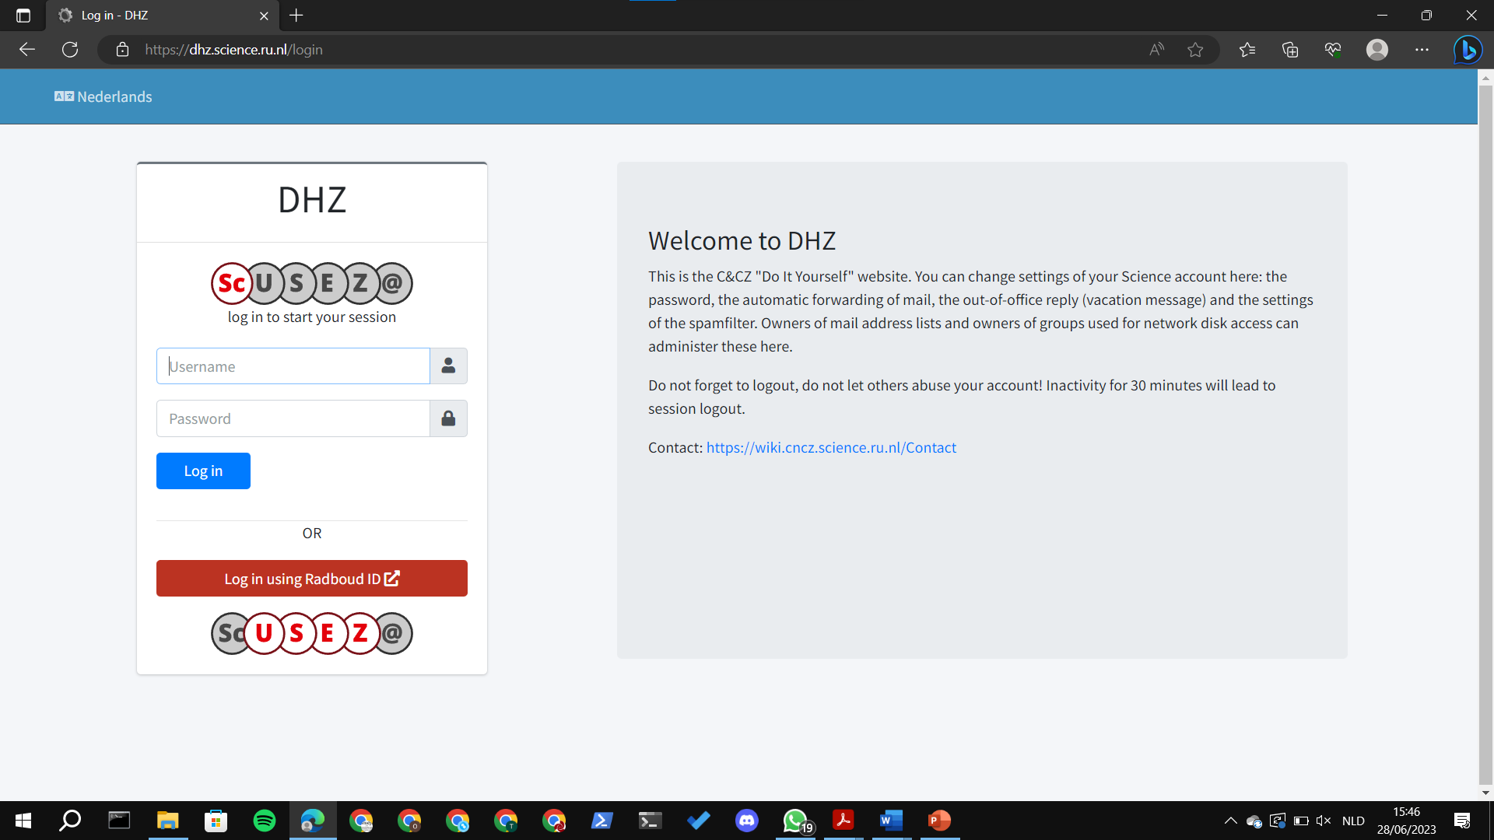
Science account
You will get an email on you RU-mail containing the username for you science account. The mail also contains an explanation of how you can activate the account.
Many students use either the science account or the “normal” account. You can automatically forward the mails you get on you science account to your own e-mail.
Notes:
They can do this in your own time
This is used rarely to log in to huygens computer

Slide 4
Logging into the WiFi
WiFi network: eduroam
Username: s1234567@ru.nl
Password: Your RU password
orientation.svcognac.nl - practical information

Slide 5
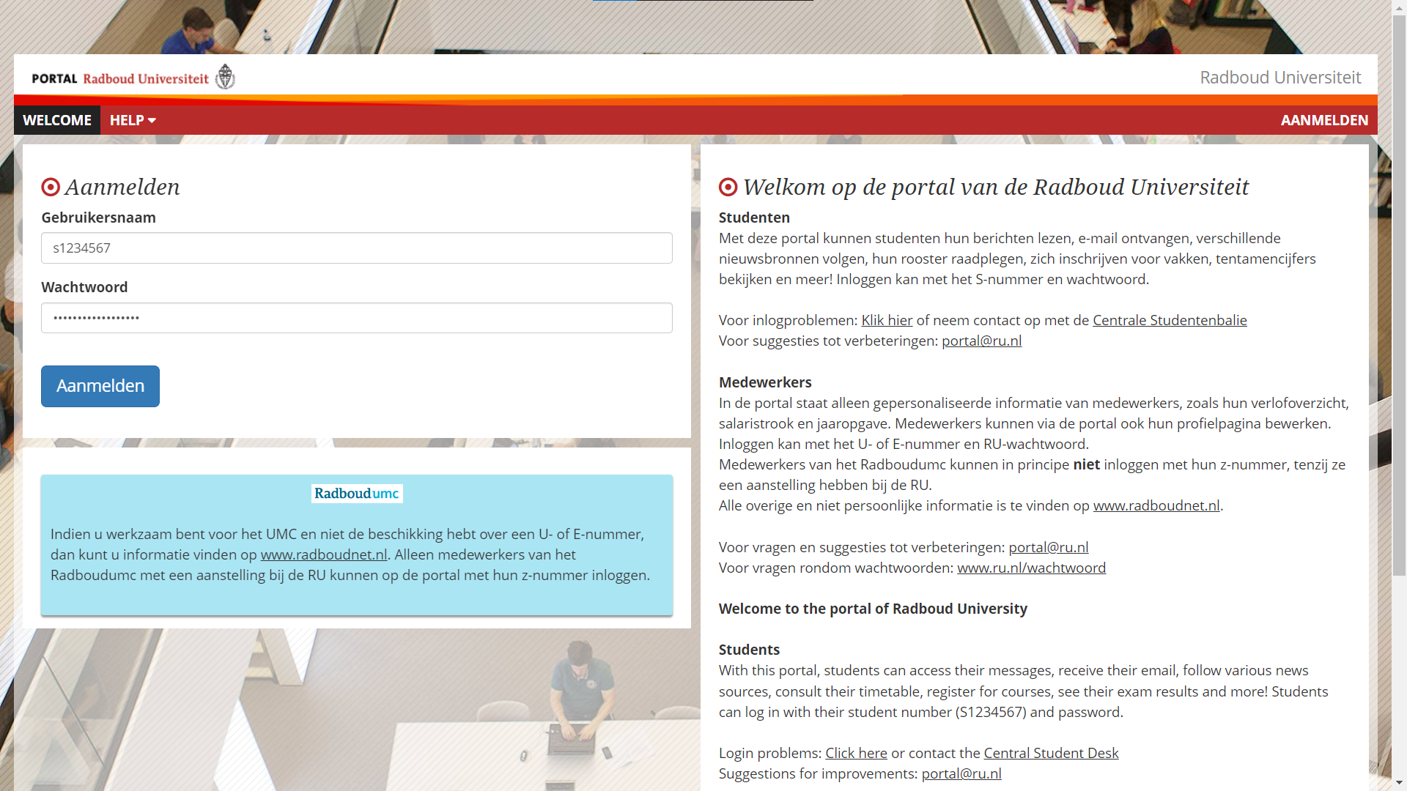
Student portal - Go to https://portal.ru.nl/
Log-in:
Username:
s1234567
Password:
RU password

Slide 6
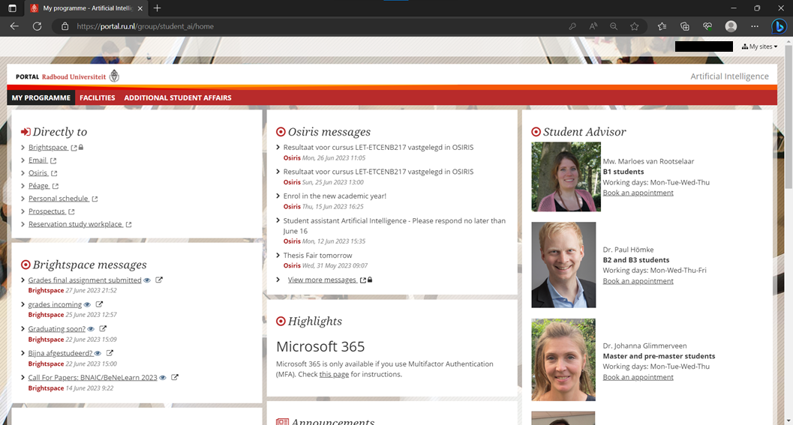
Student portal - Email
You can find your personal RU email here.
The prospectus contains information about all the courses.

Slide 7
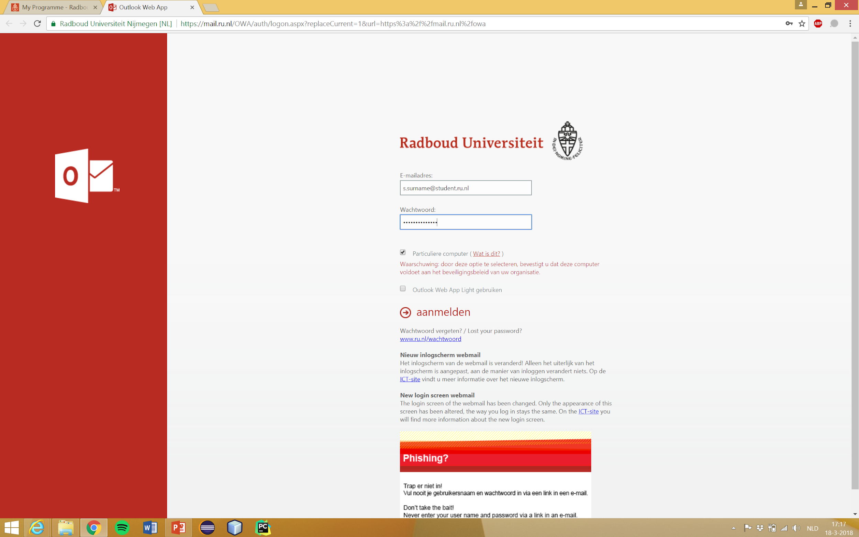
Email
Log-in:
Firstname.surname@ru.nl
Password: your password
Notes:
Note: They will need to set up authentication

Slide 8
Email
Follow the on-screen instructions
for setting up two-factor authentication
Notes:
Note: They will need to set up authentication

Slide 9
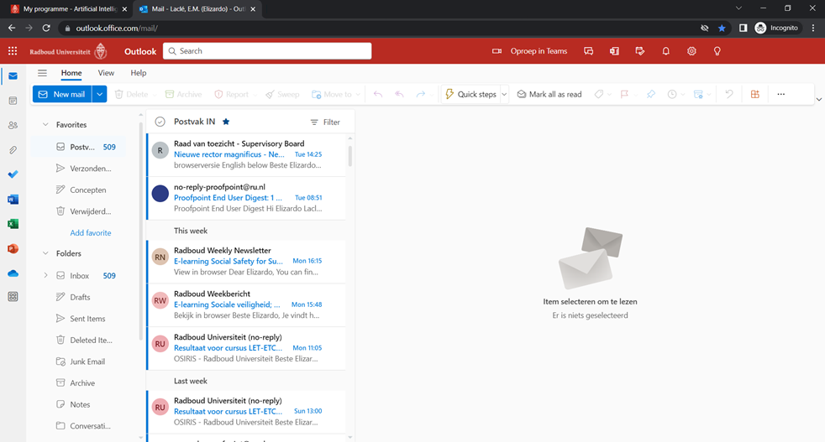
Email
This is what your email should look like.
Next we will show you how to access your RU mail from your phone.

Slide 10
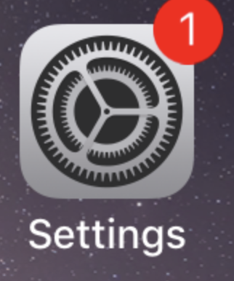
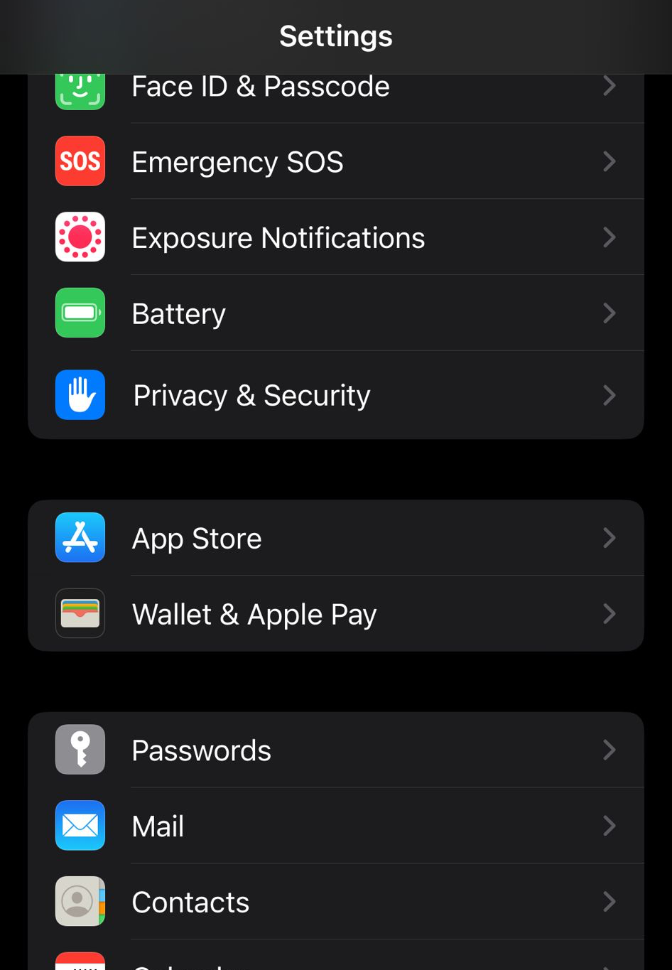
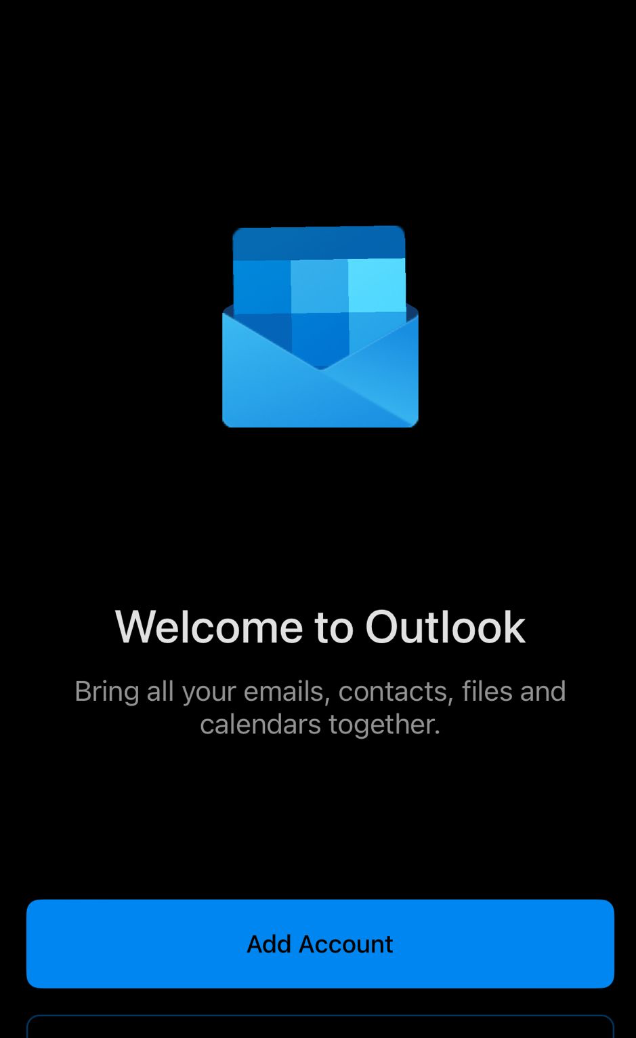
Email
Apple Mail (iPhones)
or
Outlook App (Any smartphone)
Open Settings, then Mail
Download Outlook and just sign in

Slide 11
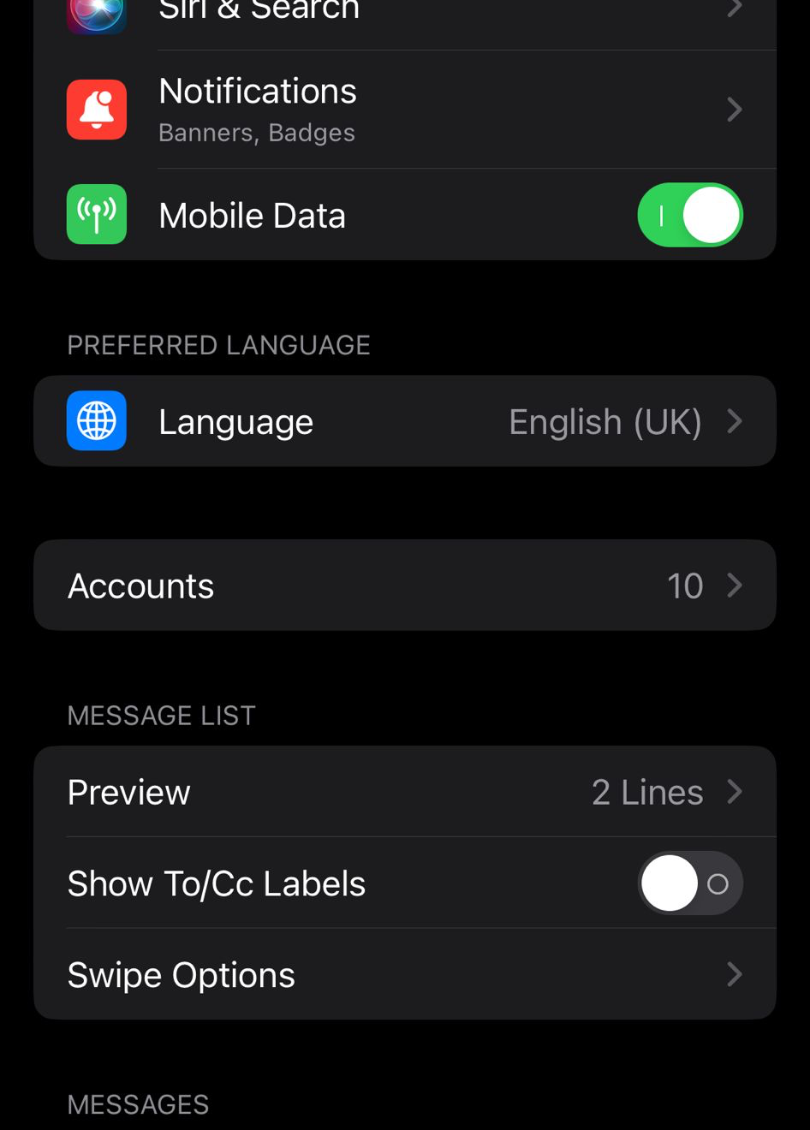
Email
Apple Mail (iPhones)
or
Outlook App (Any smartphone)
Open Accounts
Download Outlook and just sign in

Slide 12
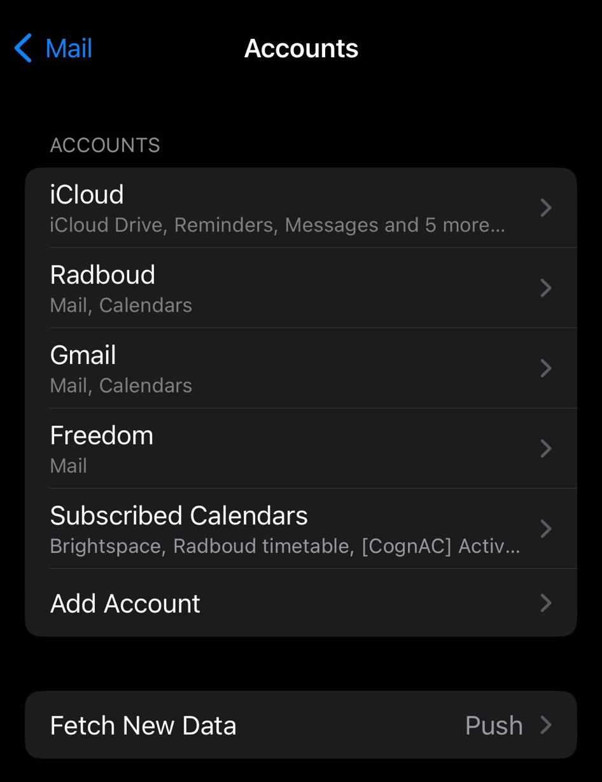
Email
Apple Mail (iPhones)
or
Outlook App (Any smartphone)
Select
Add Account
Download Outlook and just sign in

Slide 13
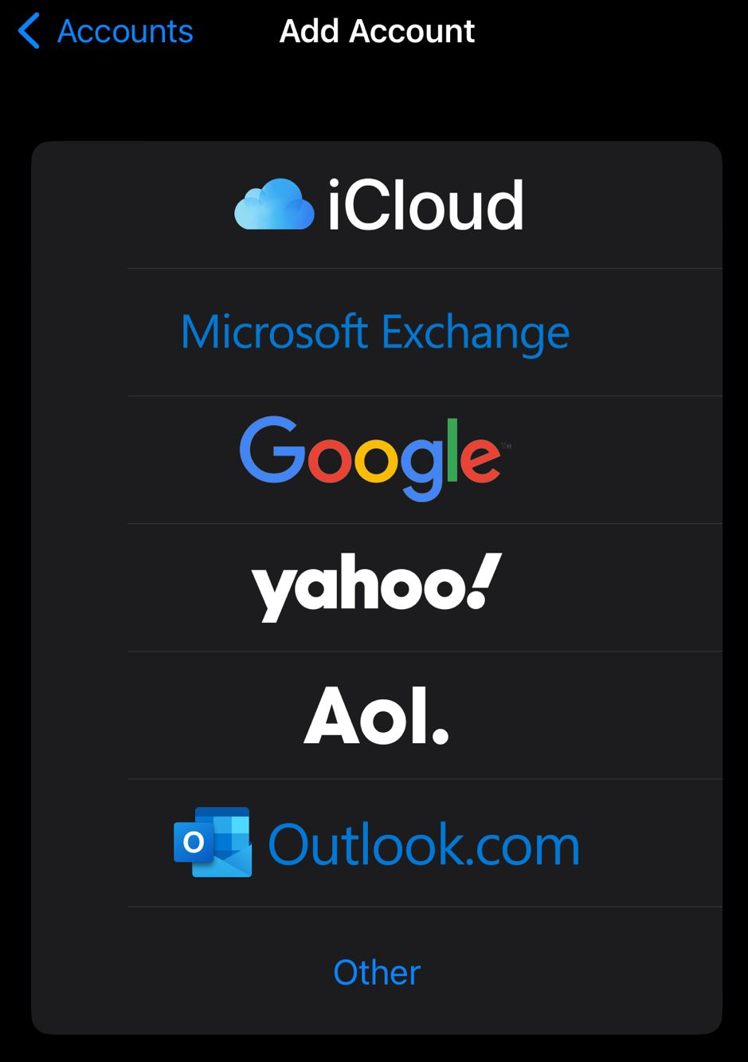
Email
Apple Mail (iPhones)
or
Outlook App (Any smartphone)
Download Outlook and just sign in
Select
Microsoft Exchange

Slide 14
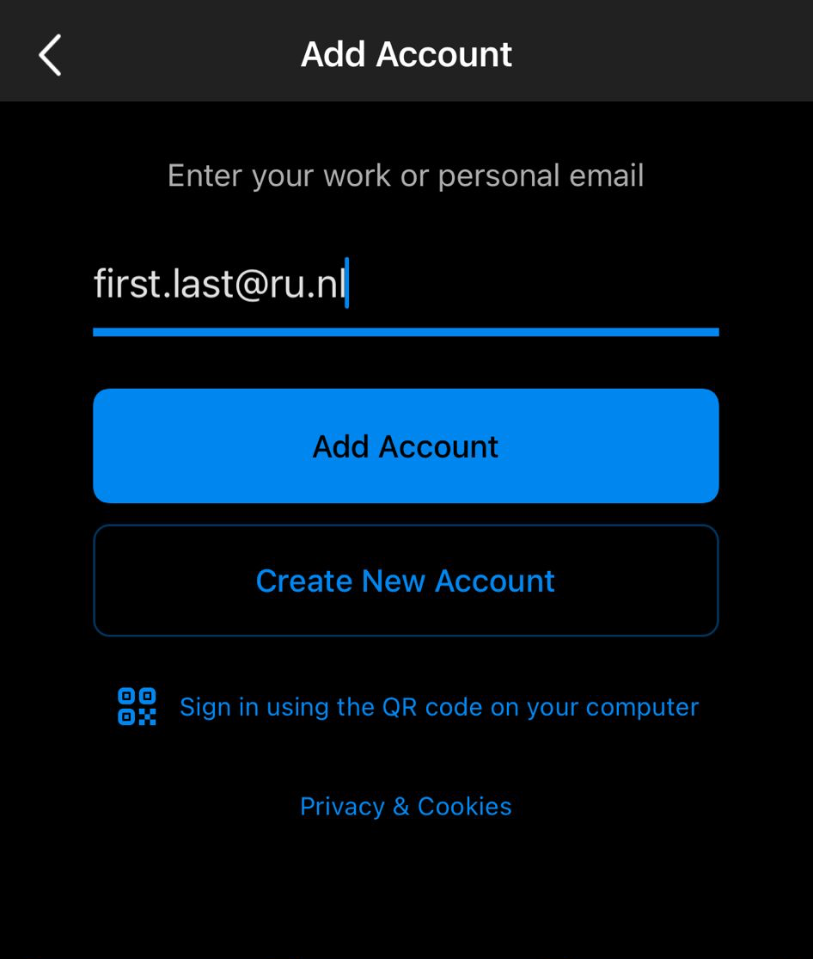
Email
Apple Mail (iPhones)
or
Outlook App (Any smartphone)
Sign in with your @ru.nl address
Sign in with your @ru.nl address

Slide 15
Printing
To print on university you need to make use of the Kuario app or login.kuario.com
You can add balance to your Kuario account and use it to print, copy and scan
Radboud has a clear explanation on how to set this up: https://www.ru.nl/fb/english/print/printing/
You dont need to print often so we wont go into detail
Notes:
ITERATE that we this is not the final setup, they need to do this in their own time with the link in this slide

Slide 16
Student portal - Osiris
Osiris is where you register for courses and where your grades will be shown.
The prospectus contains information about all the courses.

Slide 17
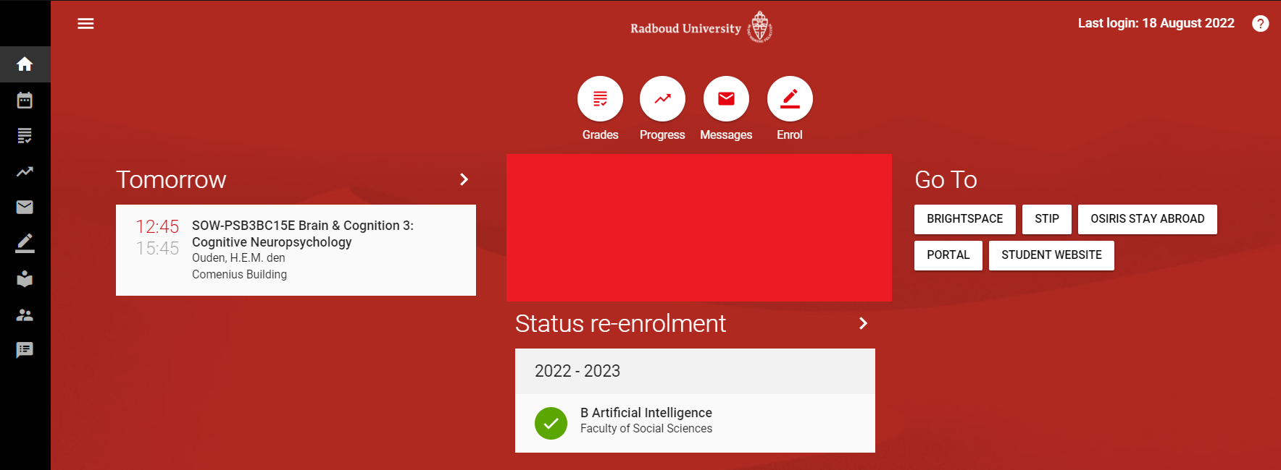
Osiris
You will be sent to a login page where you use your RU credentials.
Then you will see this screen.
To register for courses, click: “Enrol”
Notes:
You will now enrol in all of the courses

Slide 18
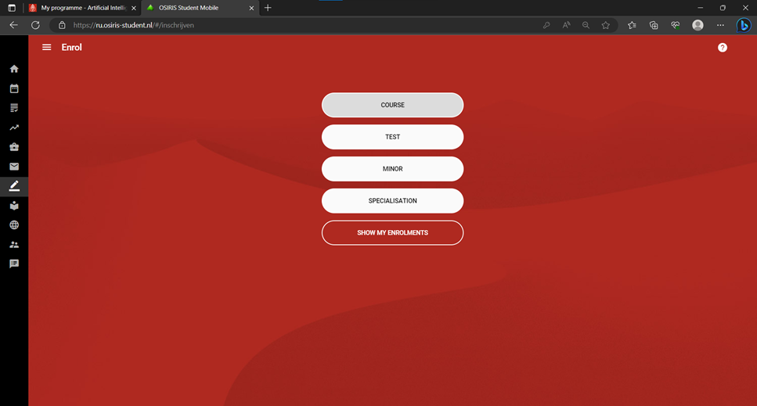
Osiris
Select course to enroll for courses and the initial exam
To enroll for resits you select test.
But hopefully you won’t need this <3
Notes:
You will now enrol in all of the courses

Slide 19
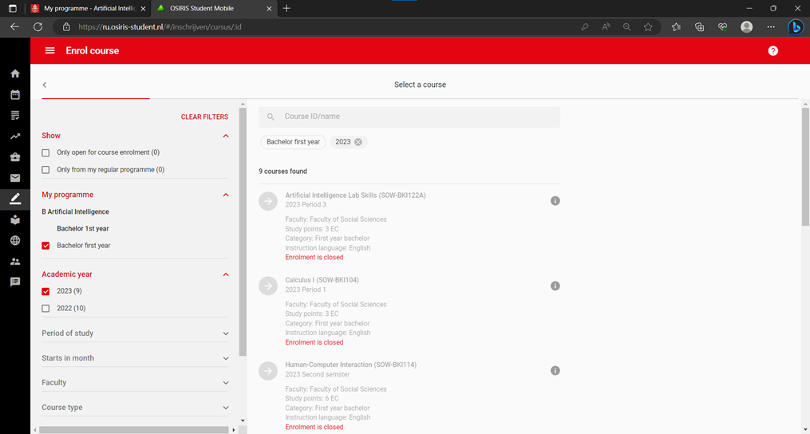
Osiris
Select BSc 1 in My programme
Enroll for ALL THE COURSES!!!!!
Notes:
You will now enrol in all of the courses

Slide 20
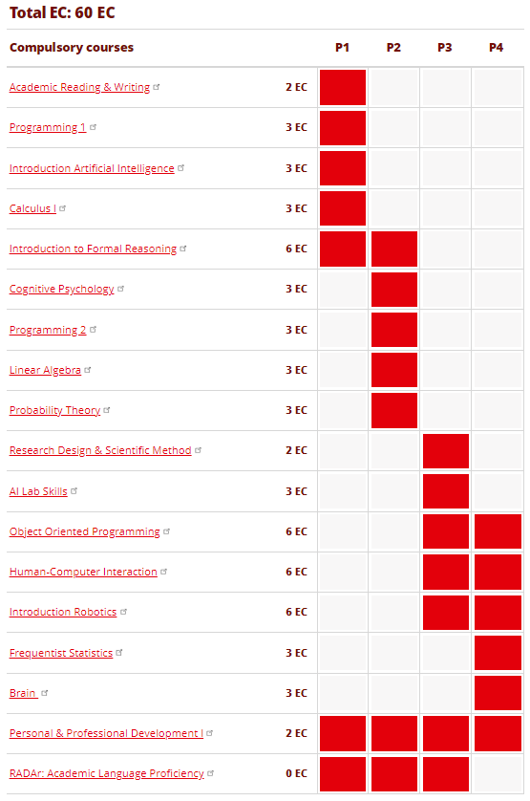
Courses
Notes:
Picture on the right is just all courses in the first year.

Slide 21
Student portal – Personal Schedule
This is where you can see your personal schedule.

Slide 22
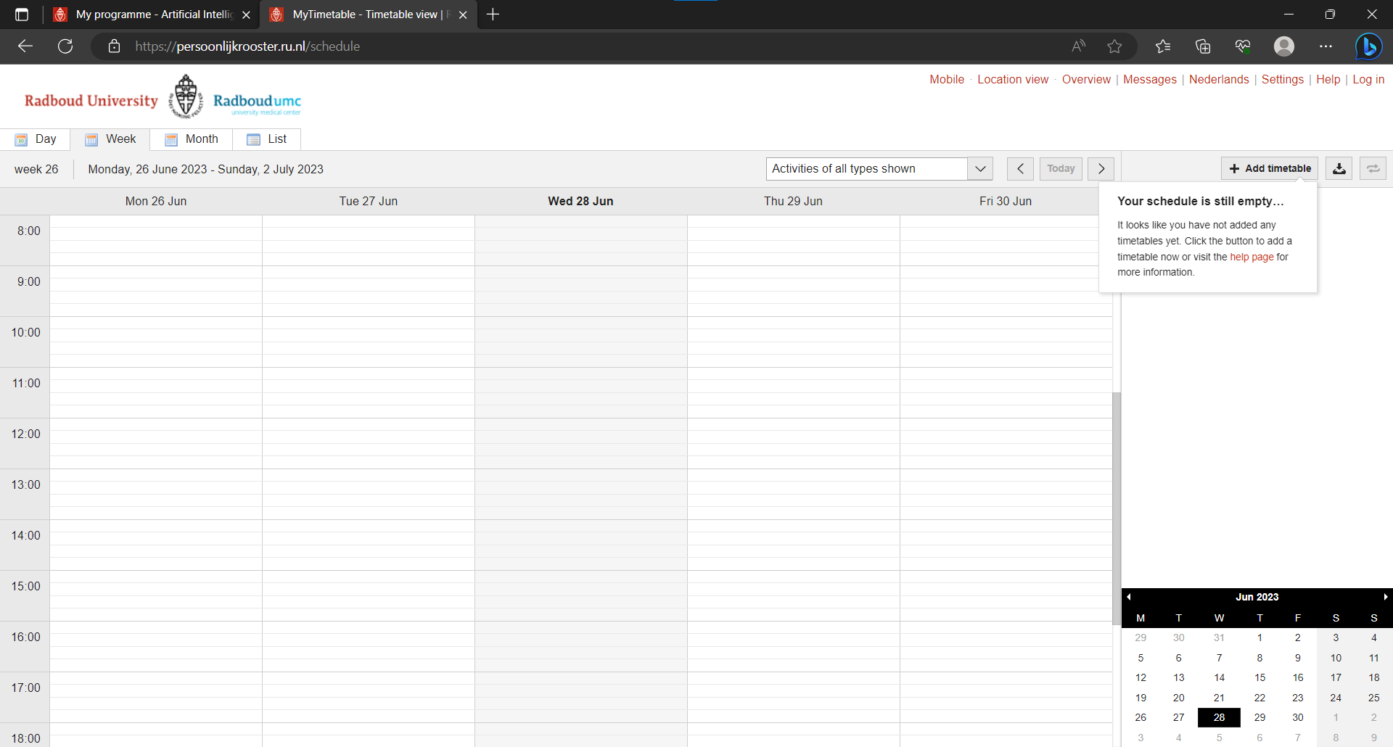
Personal schedule
You will see this page. Click on: “+ Add timetable”
Then click on: “Programme of study”

Slide 23
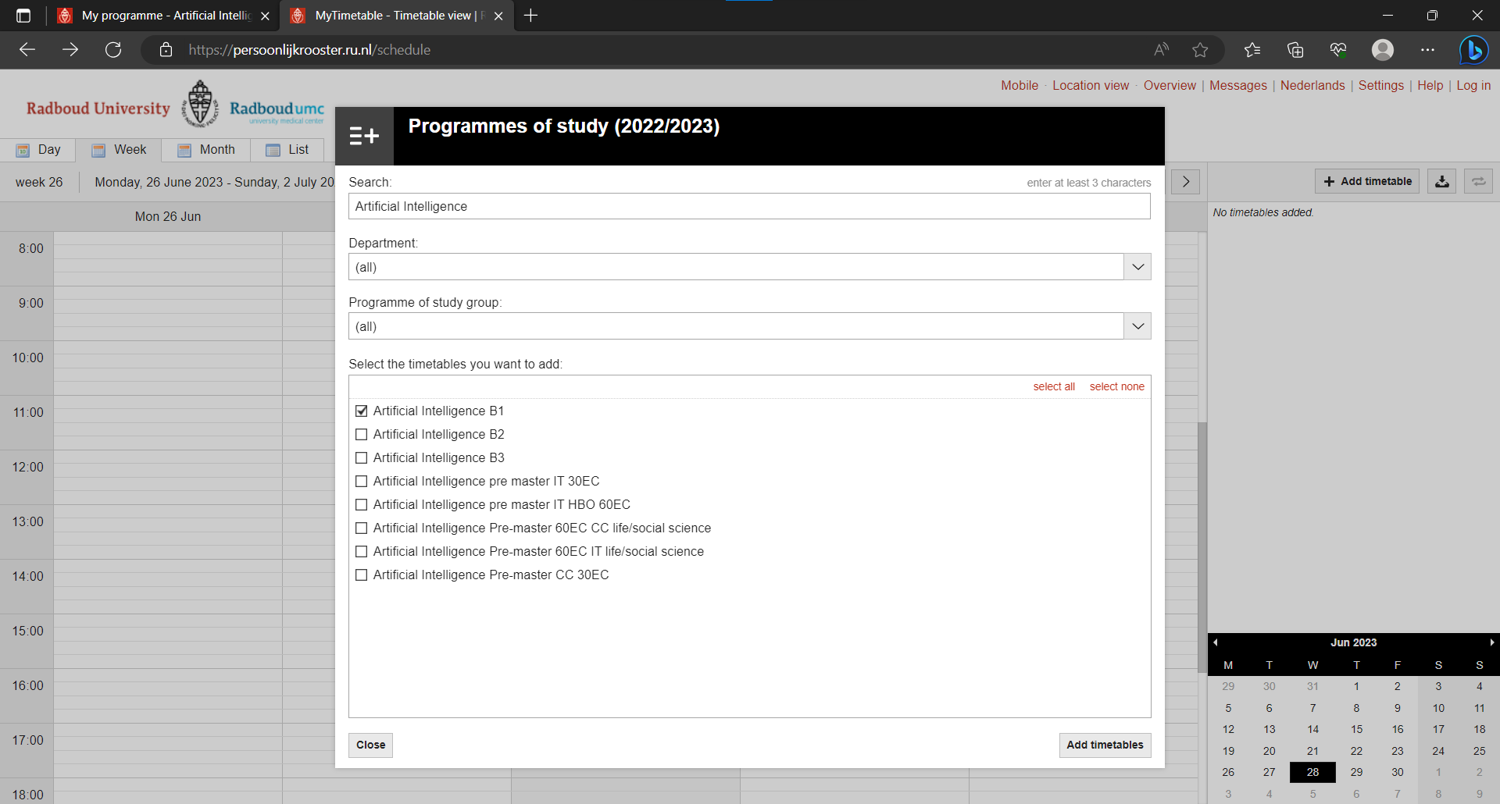
Personal schedule
Search for:
Artificial intelligence
Click on:
“Artificial Intelligence B1”

Slide 24
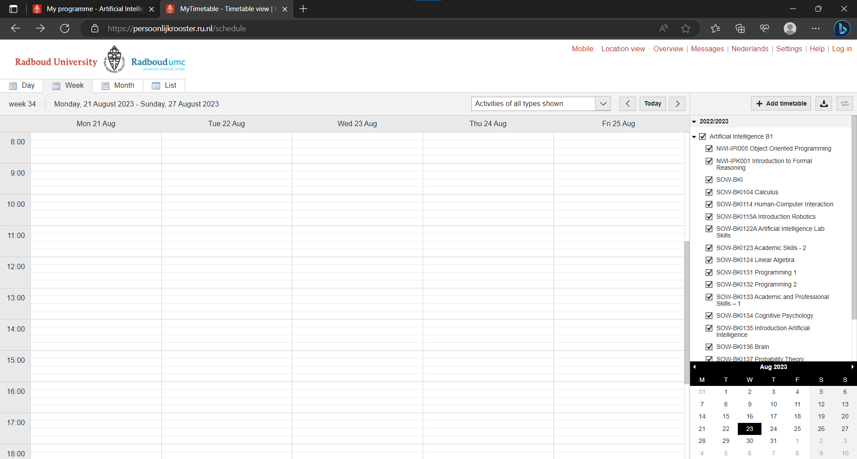
Personal schedule
You can see it on the right hand side!

Slide 25
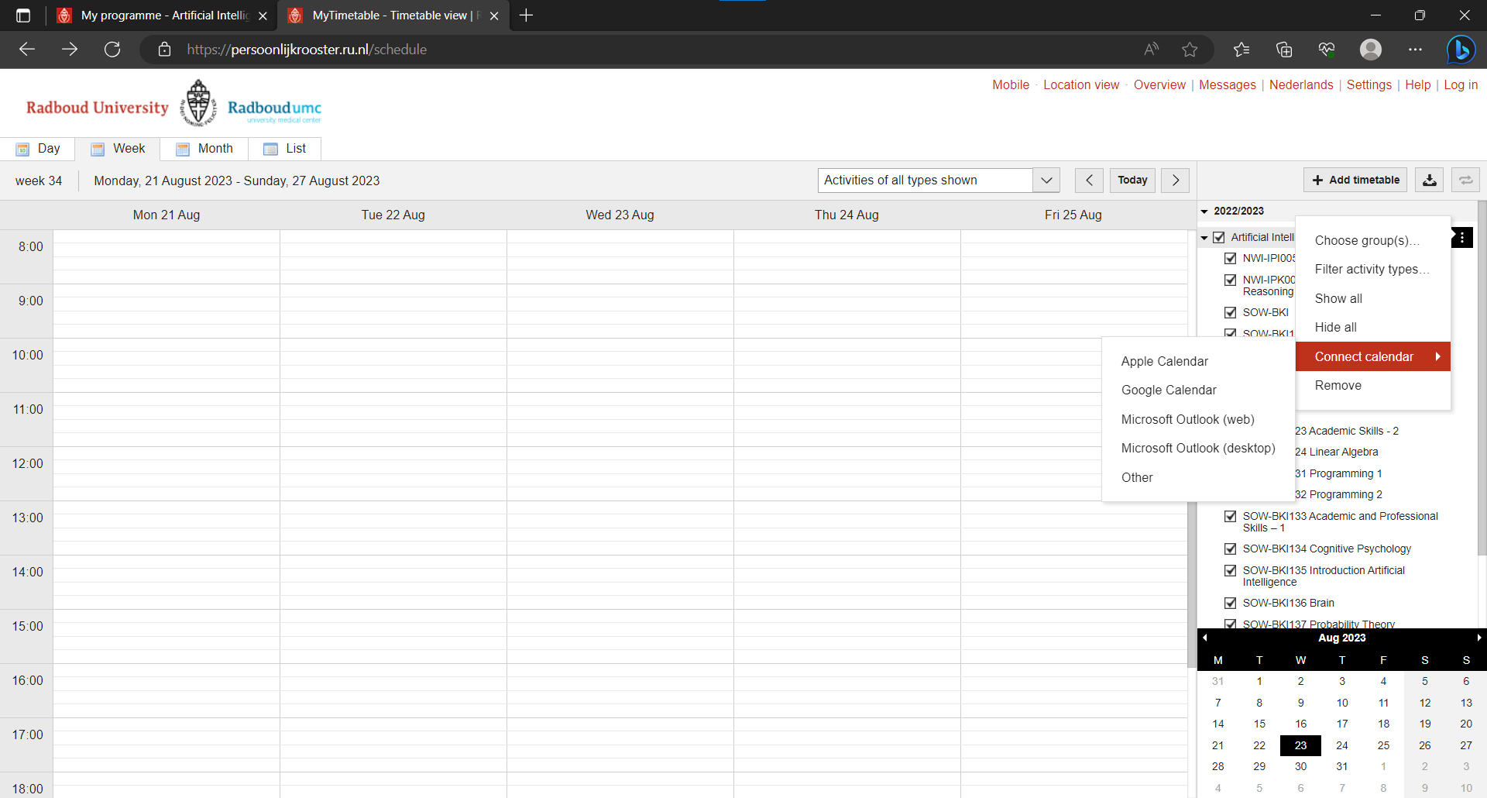
Connecting to Personal Agenda
Click the smoll buttons
Select your personal agenda

Slide 26
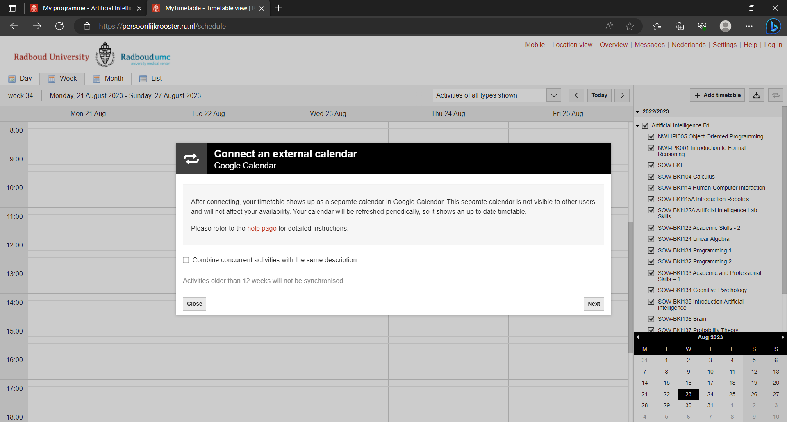
Connecting to Google
We’ll make use of Google
Press the checkbox if you want to reduce cluttering
Then press next

Slide 27
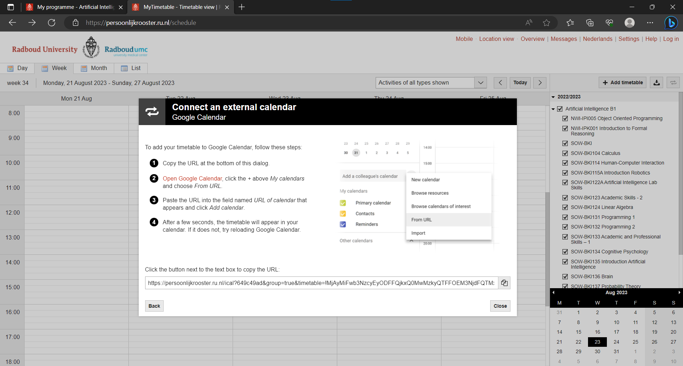
Connecting to Google
Make use of the provided steps <3
Notes:
This needs to happen in the in-browser version of google calendar, It DOES work on apple calendar on mobile

Slide 28
Student portal – Brightspace
If you press this button you will be taken to the birghtspace sign-in page

Slide 29
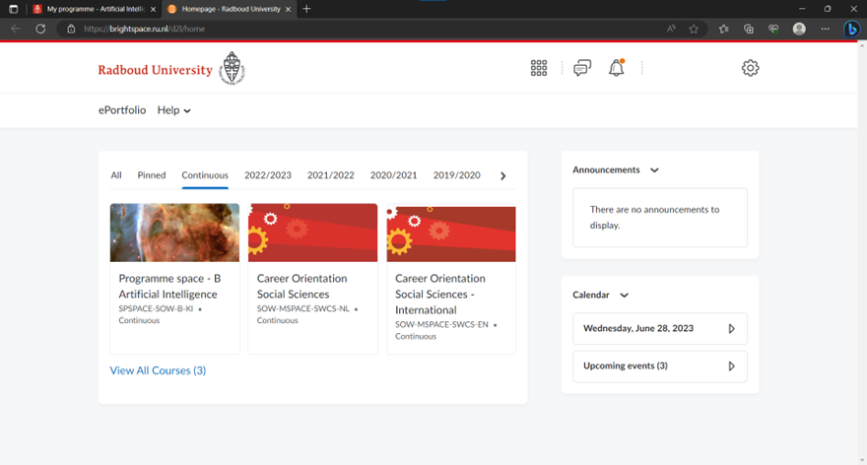
Brightspace
This is the personal page for one of the OrC members, yours will look differently!
By clicking on a course, you can get all sorts of information. Every course page will look different since the teacher of that course makes it personally.
Notes:
LET THEM ENROLL APS MENTORS, IF NOT NOW, THEY HAVE UNTIL NEXT WEDNESDAY
*VERI EMPORTENT*

Slide 30
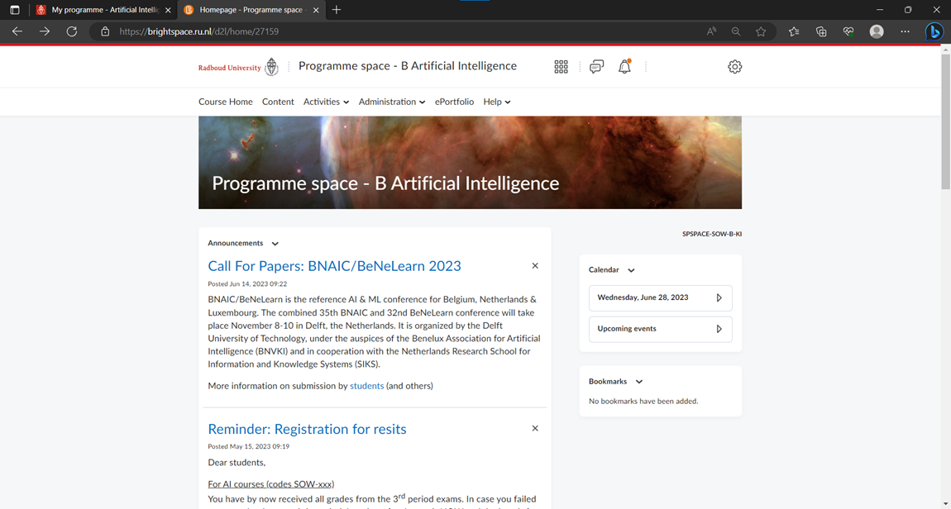
Course homepage
When you press a course you will be taken to a course homepage
(example to the right)

Slide 31
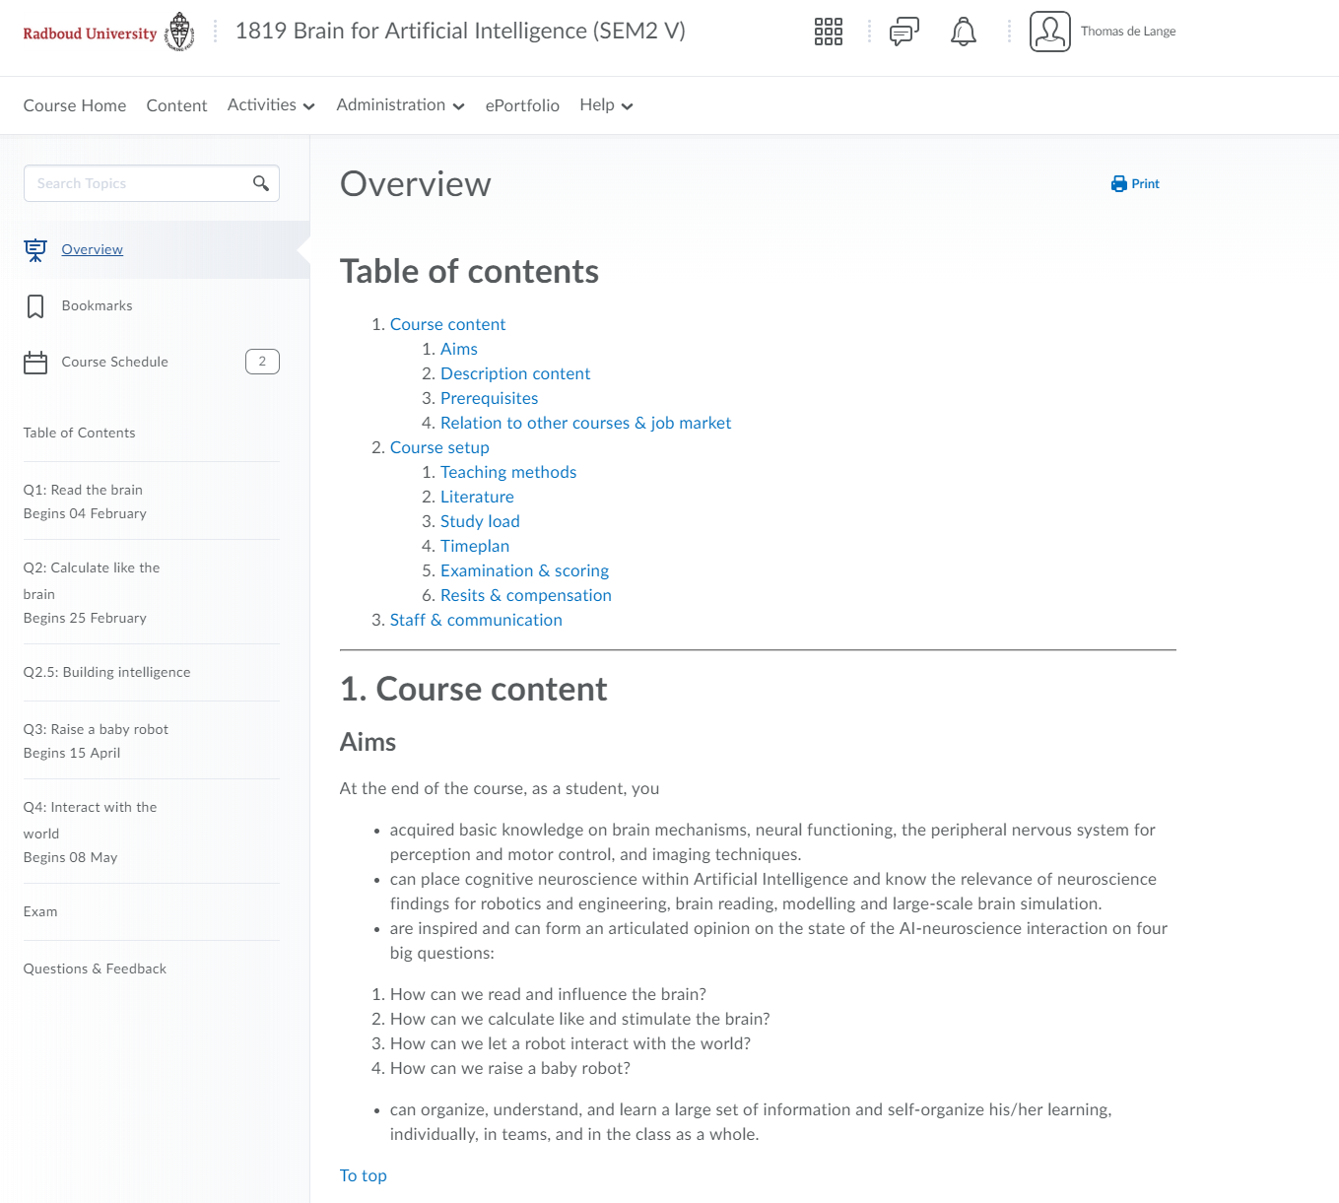
Course overview
When you press content you will be met with such a screen.
Some courses have an overview, where you can see the course setup and content

Slide 32
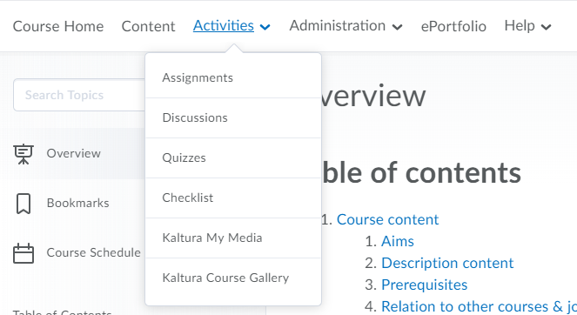
Activities tab
Under activities you can find the place to hand in assignments and the discussions board

Slide 33
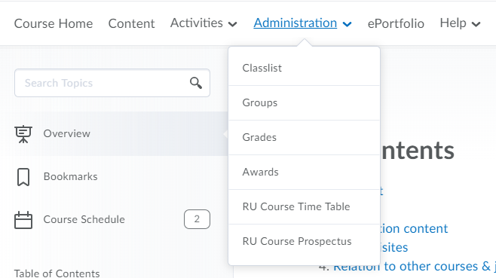
Administration tab
Here you can find the workgroups for some courses that have them. Your grades for this course are also under this tab.

Slide 34
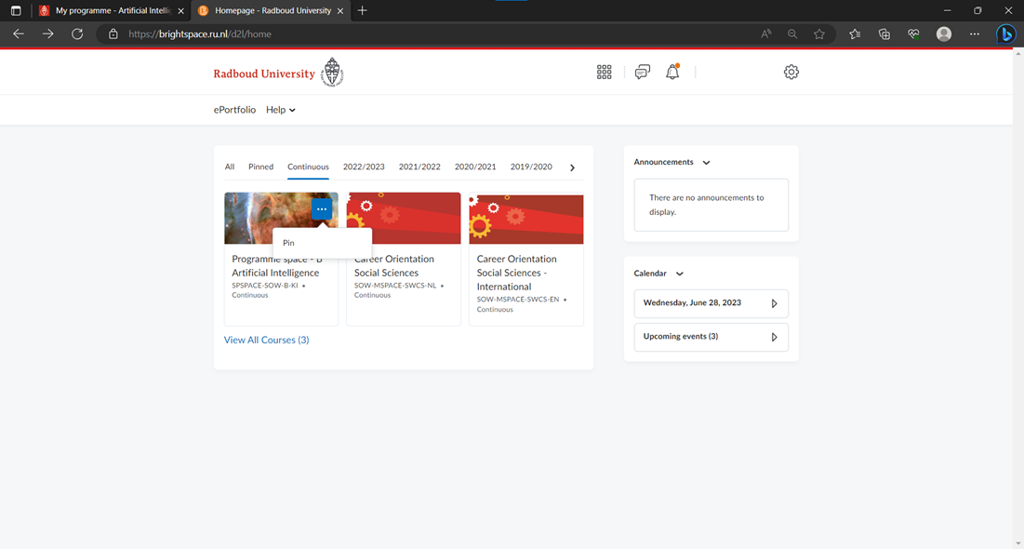
Brightspace – Pin courses
If you click here, you can choose which courses you want to see on your main page.
By clicking the pin, you can pin it on your main page.

Slide 35
Student portal – Student Advisor
When on the protal homescreen you can book an appointment here

Slide 36
Student advisor
Select ‘Student Advisor Artificial Intelligence’
Choose what kind of appointment you would like
On Campus/
By phone/
Zoom

Slide 37
Student advisor
Pick the option that says “B1” followed by your type of appointment
Pick “Marloes van Roostelaar”

Slide 38
Student advisor
Once you filled everything in you will see this
First pick the month of your appointment
Then pick your day
Lastly pick your prefered timeslot

Slide 39
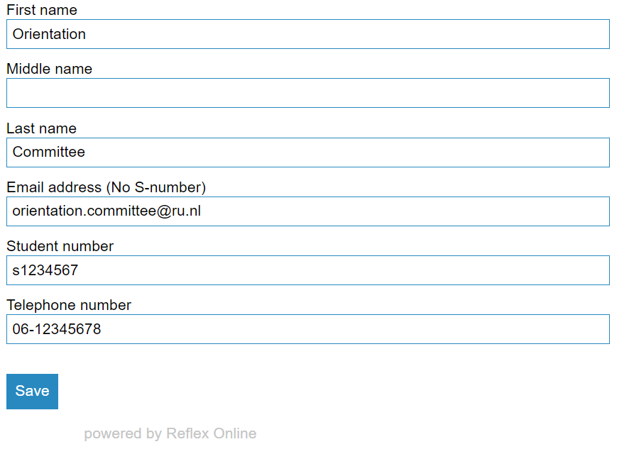
Student advisor
Personal Data
Firstname
Middlename
Lastname
Email (not your s-number!)
studentnumber
phone number

Slide 40
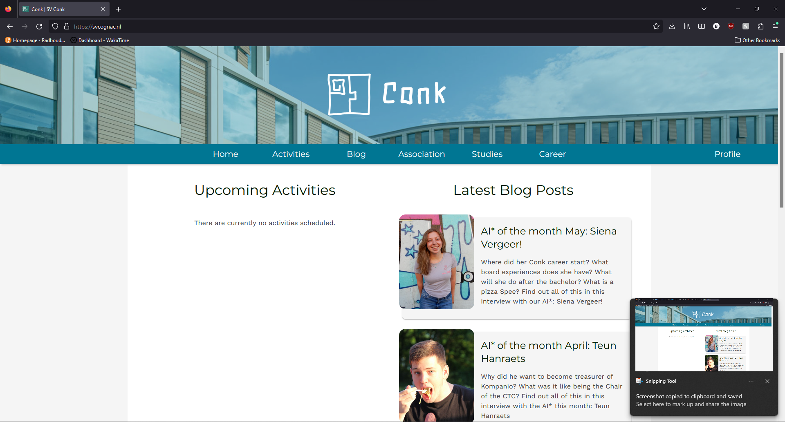
SVCognAC.nl
This is the CognAC website, you can find the activities that will take place and fun interviews. If you are a member, you can register for activities via the website.
Visit the website and have a look around!

Slide 41
The end!
Ask any questions you might still have!

